Slide 1
Online Sales Analysis
By
Isaac Mbagwu
Sales Performance Review & Business Insights Report

Slide 2
Project Overview
This project analyzes transactional sales data for an online retail company.
The objective was to transform raw data into meaningful insights using Excel dashboards to support business decision‑making.

Slide 3
Project Objectives
• Identify sales trends across regions and time
• Detect top‑performing and underperforming products
• Analyze profitability
• Build interactive dashboards
• Present business insights visually

Slide 4
Dataset Description
The dataset contains online retail transactions, including:
• Order Date
• Region / Country
• Products
• Quantity Sold
• Sales Revenue
• Cost
• Profit

Slide 5
Tools & Techniques Used
• Microsoft Excel
• Pivot Tables & Charts
• Query
• Slicers & Filters
• Conditional Formatting
• Dashboard Design

Slide 6
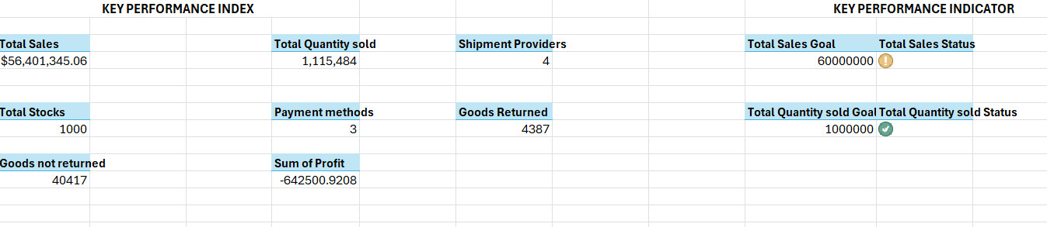
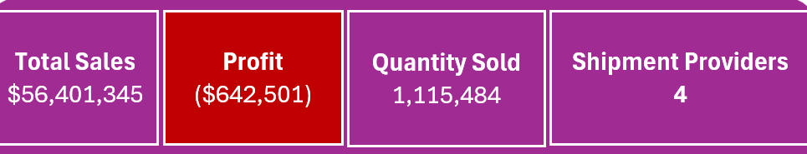
KEY PERFORMANCE INDICATORS

Slide 7
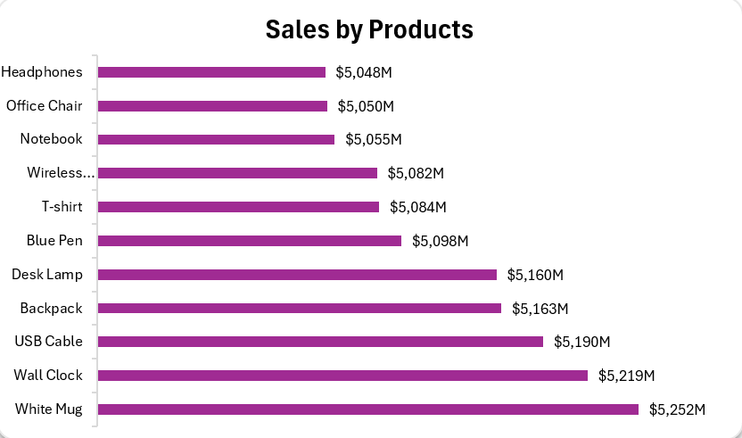
Sales trend across Products

Slide 8
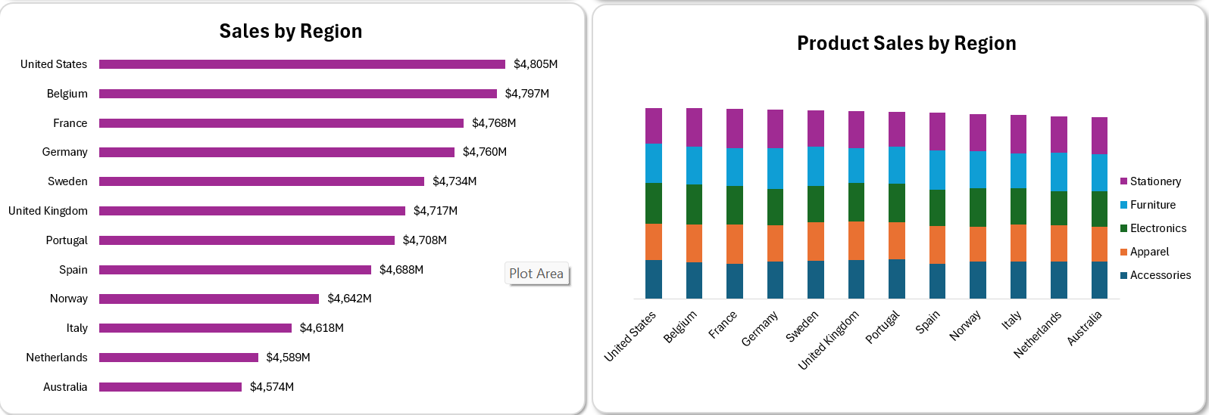
Sales across Regions

Slide 9
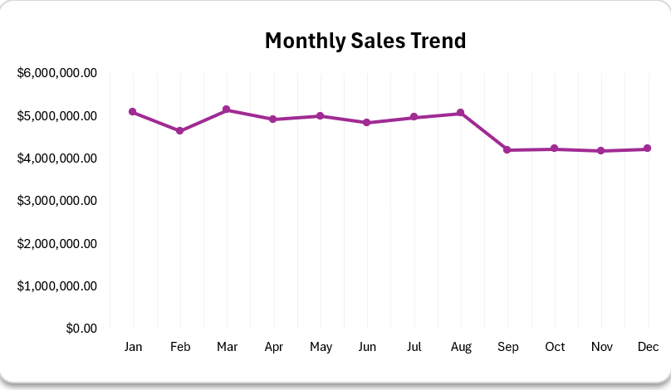
Sales trend across time

Slide 10
Key Insights
• Total Sales exceeded $56.4M
• Overall Profit recorded a loss of $642,501
• Water Bottles, USB Cables, and Backpacks were top products
• United States generated the highest regional sales
• Sales peaked between March and August

Slide 11
Business Recommendations
• Review operational and logistics costs
• Increase stock for high‑demand products
• Improve marketing in weaker regions
• Optimize pricing strategies
• Align inventory with peak demand periods

Slide 12
Conclusion
The dashboard provides a clear view of sales performance, profitability challenges and growth opportunities.
Data‑driven decisions can improve revenue and operational efficiency.

